Slide 1
Software Engineering and Architecture
Test Doubles
… getting the world under test control

Slide 2
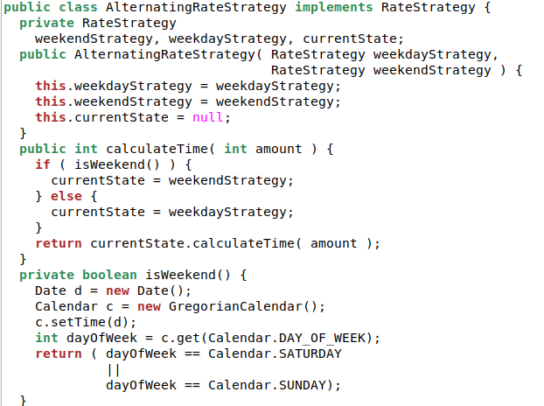
GammaTown’s RateStrategy
But how to test? How do I TDD it?
Read system clock to determine if it is weekend

Slide 3
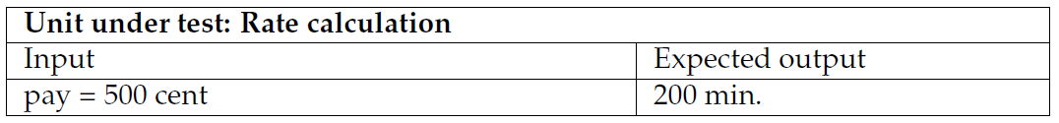
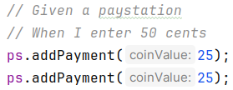
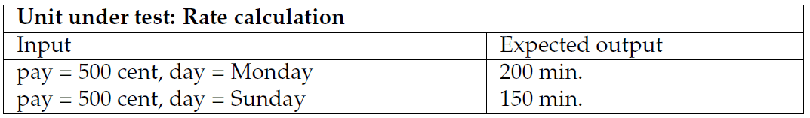
Tricky Requirement
The test case for AlphaTown:
… but how does it look for GammaTown?
, Monday) ???

Slide 4
Parameters
The test case for AlphaTown:
… but how does it look for GammaTown?
The weekday parameter is not accessible from JUnit
, Monday) ???

Slide 5
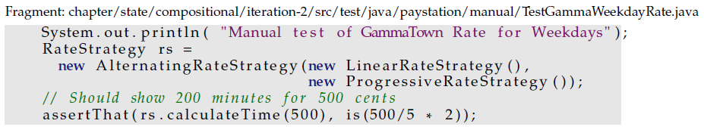
Code view
???
Direct input parameter: payment
Indirect input parameter: day of week

Slide 6
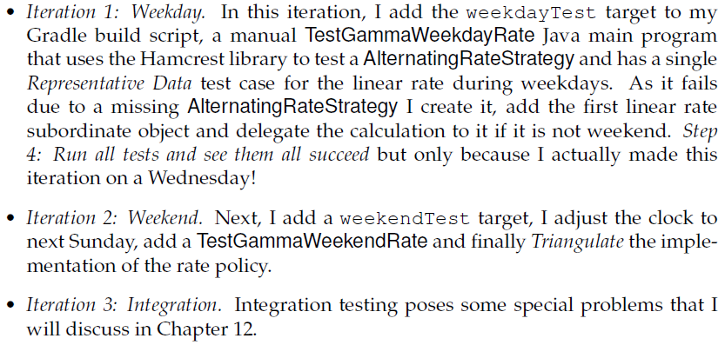
TDD of State Pattern
To implement GammaTown requirements I do it manually

Slide 7
But it is bad …
After introducing Gammatown I no longer have automated tests because I have to run some of the tests during the weekend.
  I have a ‘manual run on weekend and another run on weekdays targets’
I want to get back to as much automated testing as possible.

Slide 8
Analysis of Parameters
???
Direct input parameter: payment
Indirect input parameter: day of week

Slide 9
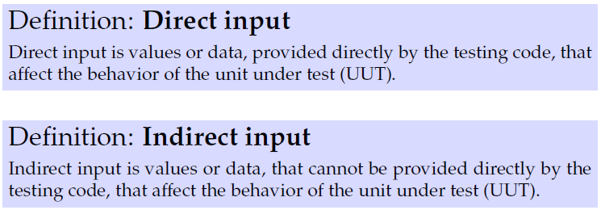
Definitions
This reflection allows me to classify parameters:
UUT = Unit Under Test.
  here it is the AlternatingRateStrategy instance...

Slide 10
Where does indirect input come from?
So, the 1000$ question is: where does the indirect input parameter come from?
Exercise: Name other types of indirect input?
Notes:
Hardware sensor readings, clock, system variables, input from configuration files, system.in, a pop-up dialogue box

Slide 11
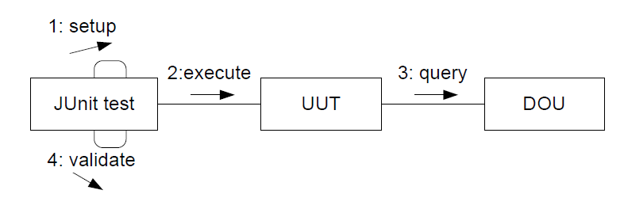
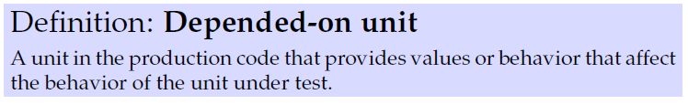
Analysis: Code view
Structure of xUnit test cases
  Collaboration diagram: interaction between objects
DOU = Depended On Unit

Slide 12
Direct versus Indirect
Direct input
Indirect input

Slide 13
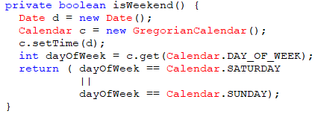
The Gammatown Rate Policy
My DOU is the Java system clock:
System Clock:
java.time package
Test code
AlternatingRateStrategy
Method parameters
Calling library methods

Slide 14
The Challenge
This analysis allows me to state the challenge:
How can I make the DOU return values that are defined by the testing code?
System Clock
System.DateTime
java.util.Calendar
Test code
AlternatingRateStrategy

Slide 15
Analysis
Basically, it is a variability problem
  During testing, use data given by test code
  During normal operations, use data given by system
So, I can reuse my previous analysis
  parametric proposal
  polymorphic proposal
  compositional proposal
Scientists like to do this all the time! If we can rephrase a new question into an old one, whose answer is known – then we are done ☺

Slide 16
Parametric
This is perhaps the oldest solution in the C world
#ifdef DEBUG
today = PRESET_VALUE;
#else
today = (get date from clock);
#
return today == Saturday || today == Sunday;

Slide 17
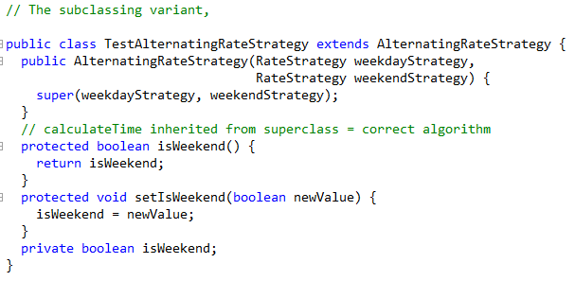
Polymorphic
Subclassing...
Actually, a quite reasonable approach...
  If you locate the TestAlterna… in the /test tree in the codebase
Argue why!!!
Hm, liability: Have to make isWeekend() ‘non private’
AlternatingRateStrategy
TestAlternatingRateStrategy
Notes:
Why? Because here the subclass is in the test code, not in the production code; we just use it in one single test to tweak some indirect input. So the ‘cost of subclassing’ is very small, compared to the issues often seen (and outlined in the FRS strategy pattern chapter) when using subclassing in production code.

Slide 18
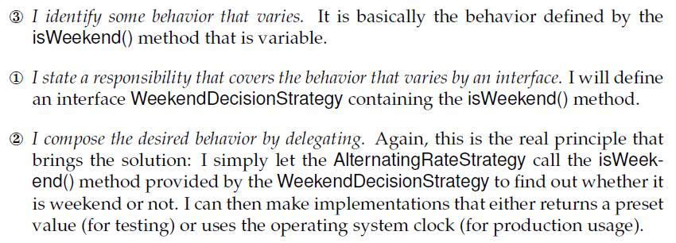
Compositional
3-1-2 leads to yet another Strategy Pattern:

Slide 19
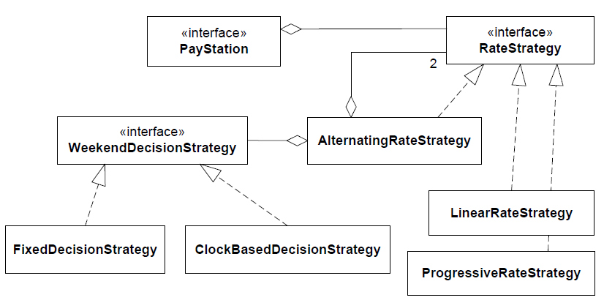
Static Architecture View
Exercise: Why is this Strategy and not State?

Slide 20
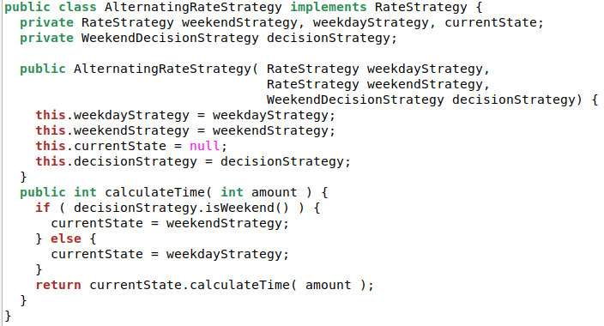
Production Code
The algorithm to compute if its weekend is delegated to our decisionStrategy

Slide 21
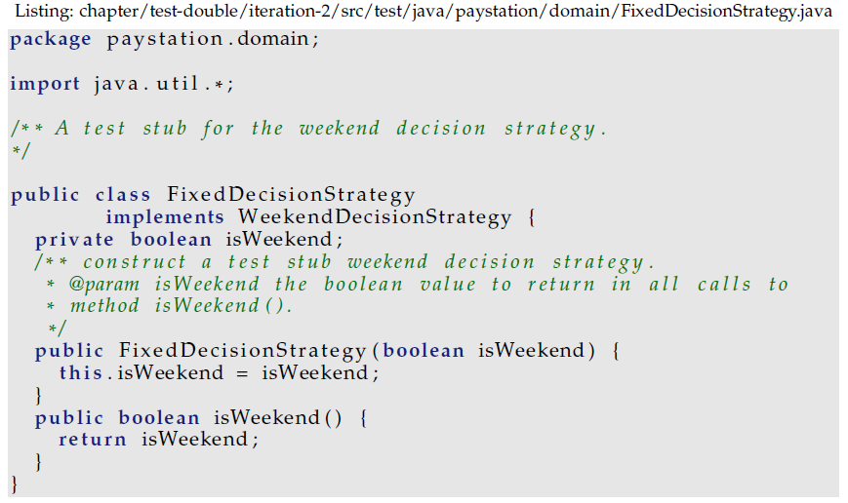
The Stub
To make a deterministic test; we write an implementation which makes the ‘indirect input’ into ‘direct input’
  That is, we get the ‘is-it-weekend’ under direct control of our test code
Side note: Which Uncle Bob property do I violate here ☹?
Notes:
I violate : Avoid Flag Arguments

Slide 22
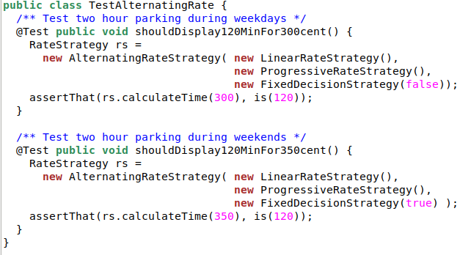
Now the Test Code is:

Slide 23
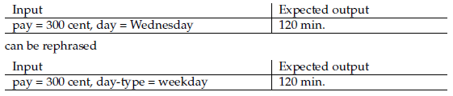
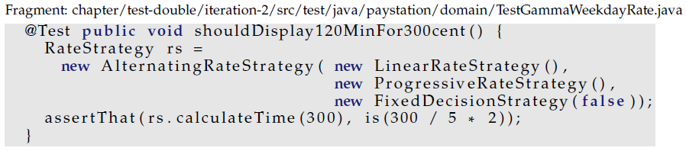
Rephrasing as Test Case
Direct input parameter: payment
Now: Direct input parameter: weekend or not

Slide 24
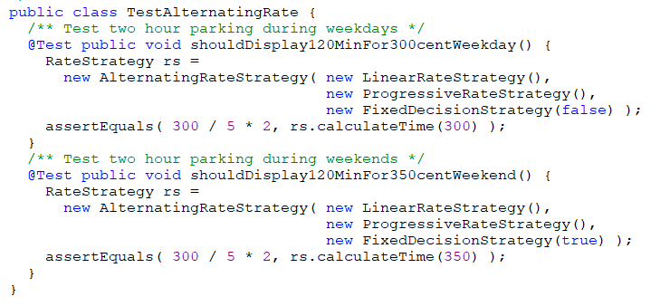
Side note: Sorry Bob ☺
On my ToDo … introduce an Enum type
  No flag argument, replaced by descriptive names
IS_WEEKDAY
IS_WEEKEND
Notes:
Avoid Flag Arguments

Slide 25
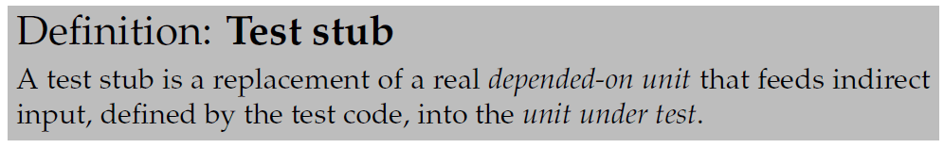
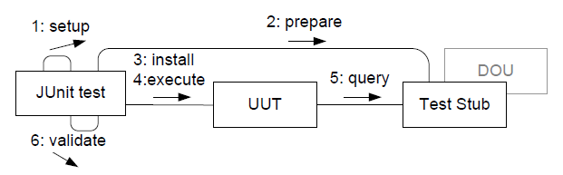
Test Stub
The new delegate is an example of a test stub
Stub returns ‘canned’ input

Slide 26
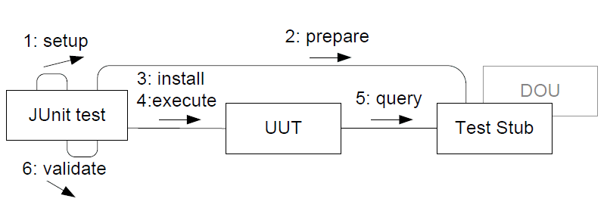
UUT Queries served by Stubs
Test Stubs serve queries (accessors) by the UUT
Stubs are simple implementations (‘Evident Tests’)
Stubs return canned or configured input to UUT
  ‘setNextValueToReturn(3);’ return nextValue;
  return 3;
Fix what is returned by the DOU

Slide 27
Test Doubles
The Stub is just one type of ‘replacement delegate’
The superclass: Double

Slide 28

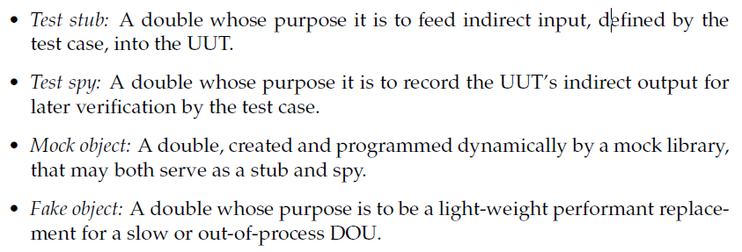
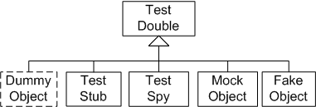
Meszaros (2007)
There are actually several types of ‘replacements’…
Double???
From the term ‘stunt double’ in movie making

Slide 29
Test Spy
Spies serve commands (mutators) by the UUT
Spies are recorders of interaction
  So, JUnit test can later query the spy about “what happened?”
Again, simple implementations (‘Evident Tests’)
  If not, the bugs will be in the spy, not in the UUT ☹
command
What was sent to the DOU?

Slide 30

Example
Chemical plant
  Control temperature in chemical
  process
Algorithm
  Measure the temperature
    Query the temperature sensor
  Compute a response
    If (T > 67) then cool the process; if (T < 62) then stop cooling;
  Activate the cooling system
    Command the cooler to turn On
Manual testing:
  Let the process run; if plant explodes then the test has failed ☺

Slide 31
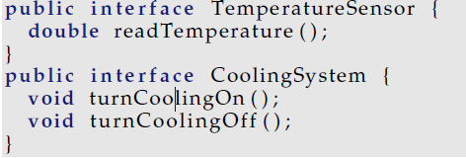
The UUT
The UUT (Unit-Under-Test) is of course the algorithm, the monitoring of the chemical process:
  Compute a response
    Measure T
    If (T > 67) then Turn on Cooling
But there are two DOUs involved
  TemperaturSensor
  CoolingSystem

Slide 32
The Test Doubles
So we need two test doubles
Exercise:
  Indirect input?
  Indirect output?
  Stub? Spy?
Temperature
Sensor
PlantMonitor
Cooling
System
UUT
DOUs

Slide 33
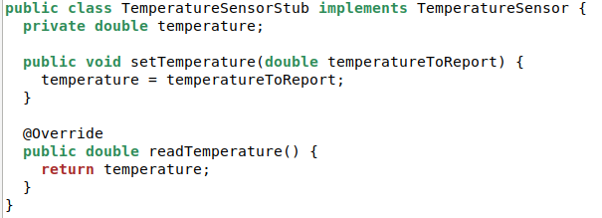
The Stub, you all know now
Stub: Simple implementation, returning indirect output that is either canned or configured.
  We want to control the indirect output, so we just provide a method to configure it
Note: No ‘@Override’. It is a method just implemented in the stub!

Slide 34
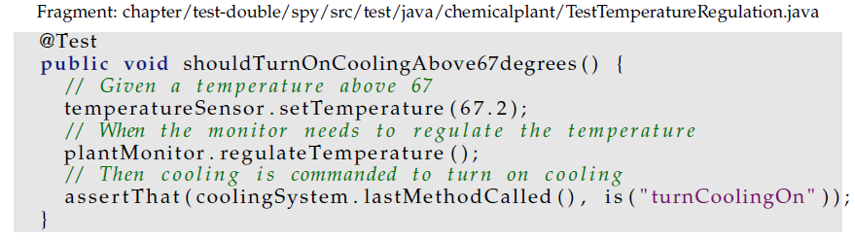
So: A TestCase
Given T > 67 Celcius, When asked to monitor, Then cooling is turned on

Slide 35
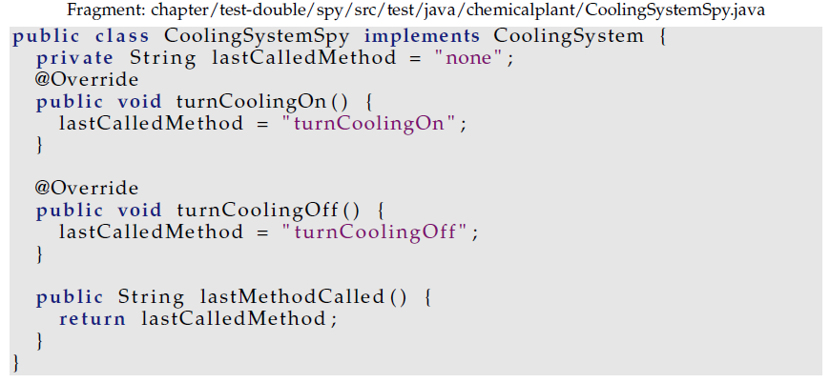
Spy
Spies are recorders of interaction
  So, JUnit test can later query the spy about “what happened”
Note: No ‘@Override’. It is a method just implemented in the spy!

Slide 36
As used in…
Validate that the cooling was turned on…

Slide 37
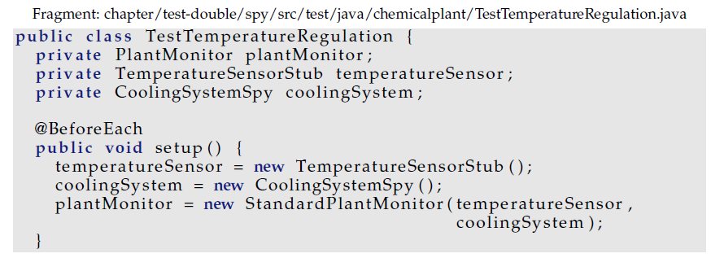
Retrieval Interfaces
Retrieval Interfaces: Special methods for setting and inspecting state in doubles, only defined in the test double classes themselves!
  I.e. the real temperature sensor should of course not have a method to set the temperature, right?
Thus, doubles are often declared by class, not interface

Slide 38
Side Note
Retrieval interface are
  “The role that the object must play, as seen from the test perspective”
  It is a specific role that is only related to testing
As such it could be designed by a
Role Interface / Private Interface
… as introduced later in the course ☺

Slide 39
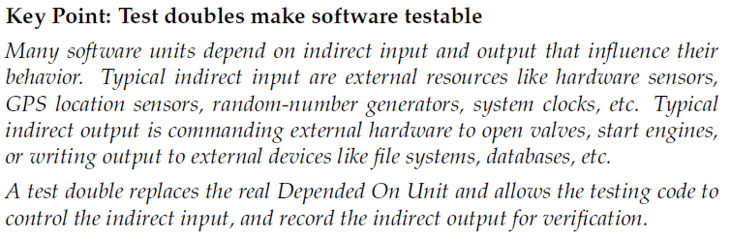
Key point
Allow us to test the nuclear reactor core control software without doing the ‘Tjernobyl test’…

Slide 40
Note
Please note that once again the 3-1-2 is the underlying and powerful engine for Test Doubles.
  Encapsulate the temperature sensor that (3) varies, by defining an interface (1), and then use delegation (2) to let ‘someone else read the temperature’
I use the 3-1-2 to derive a solution that “accidentally” has a name and is a well-known concept; just as I previously derived several design patterns.

Slide 41
And .. They are roles not objects
We will discuss roles at length soon but…
Test Stub and Test Spy are not mutually exclusive!
  The are ‘roles’ or ‘types’ that an object plays/is!
Thus, a given test double object may be both a spy and a stub
  Spying on commands coming from the UUT
  And Stubbing queries coming from the UUT to enable the test case to work…

Slide 42
What about?
The other two types of doubles?

Slide 43
Fake Object
... Is not needed in SWEA
They are light-weight, performant, replacements for slow or out-of-process/networked DOUs
Examples
  Replacing a database with a in-memory hashmap
  Replacing a REST service with a simple in-memory impl.
Both are out-of-process – that is you have to start an external service (a DB, a web server) which is difficult from within JUnit

Slide 44


Mocks
… are “even more not used” in SWEA (yet)
Mocks are auto-generated doubles, made by libraries.
Example: Mockito
  You need to tell Gradle to pull the library, of course…
  … which allows you to

Slide 45
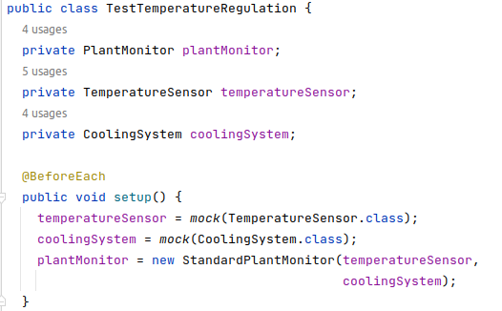
Mocks
Creating your stub/spy is easy, just tell Mockito to do it!
Note also: Declared by interface, not by concrete type!

Slide 46
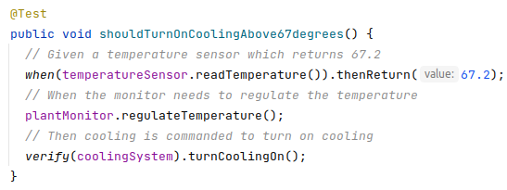
Mocks
Using Mocks you “program” your stub and spy behavior using the Mockito API, not by coding Java.

Slide 47


Mocks or Not
Personally, I am a bit torn on ‘to use or not?’
The benefit
  “Quickly” add a test – I just say ‘mock(Database.class)’ and I have a stub + spy for it…
  Quite elaborate verifications possible
    Ordering, never, 10 times, any…

Slide 48
Mocks or Not
The liabilities
  I am not programming in Java!!!
    I am coding in obscure when()/verify() syntax
      No help from IntelliJ
      No help from 25+ years of experience
      I often find myself trial/error coding – It is not ‘evident test’
  Vendor Lock-in = I am stuck with a specific library
    Changing to EasyMock or jMock? Bad luck, rewrite all your tests!
  The Mockist approach slippery slope into white-box tests
    Tendency to test How things are done, not What was done…
So – use it with care…
  (I did my EtaStone tests using Mockito, though, and loved it ☺)

Slide 49
Reusing the variability points...
Aah – I could do this...

Slide 50
Variability points to the rescue
The WeekendDecisionStrategy introduces yet another variability point...
Often they come in handy later if
  1) they encapsulate well-defined responsibilities
  2) are defined by interfaces and
  3) uses delegation ☺

Slide 51
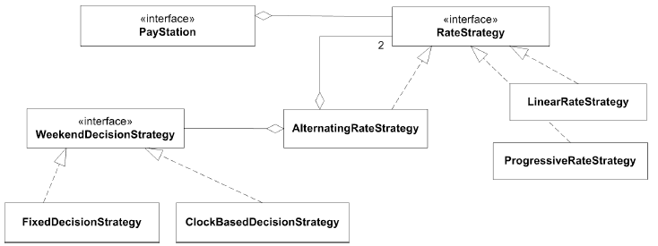
Static Architecture View

Slide 52
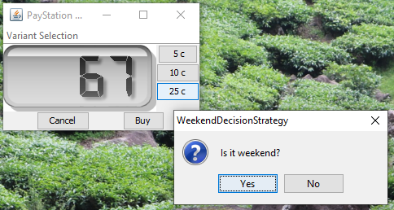
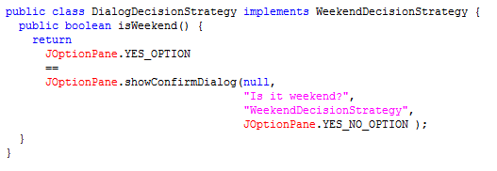
Manual testing
Manual testing of GammaTown, for demo to end users!

Slide 53
Discussion

Slide 54
Package/Namespace View
Gradle dictate that we split the code into two trees
  src/main/java: all production code rooted here
  src/test/java: all test code rooted here
Here
  WeekendDecisionStrategy (interface)
  ClockBasedDecisionStrategy (class)
  FixedDecisionStrategy (class)
Exercise: Where would you put these units?
Notes:
Fixed should be in test tree as it should not be deployed at customer site

Slide 55
C# Delegates / Java 8 Lambda
The WeekendDecisionStrategy only contains a single method and having an interface may seem a bit of an overkill.
  In Java 8, you can use a Lambda
  In C# you may use delegates that is more or less a type safe function pointer.
  In functional languages you may use higher order functions, closures

Slide 56
Summary

Slide 57
Key Points
Test Doubles make software testable.
3-1-2 technique help isolating DOUs
  because I isolated the responsibility by an interface I had the opportunity to delegate to a test stub
My solution is overly complex to our weekend issue
  Yes! Perhaps subclassing in test tree would be better here ☺
  But
    it scales well to complex DOUs
    it is good at handling aspects that may vary across the entire system (see next slide)

Slide 58
This is a PowerTool
Test Doubles usage are a key technique in modern, microservice, continuous deployment, development!!!
  Build servers that automatically pull git repositories for newest releases, runs extensive tests, and finally pushes code into production on the production servers…
It would not be possible if stubs, spies, fake objects, mocks were not used to thoroughly test using automated testing!
Example:
  NetFlix need to survive server crashes to continue streaming
    Test stubs (‘saboteurs’) throw IOExceptions to simulate failures…

Slide 59
Still Untested Code
Some code units are not automatically testable in a cost-efficient manner
  Note that if I rely on the automatic tests only, then the ClockBasedDecisionStrategy instance is never tested!
    (which it actually was when using the manual tests!)
Thus:
  DOUs handling external resources must still be manually tested (and/or formally reviewed by software reviews).
  Keep ‘non-testable code’ in the smallest possible software unit, and if it ain’t broke, then don’t fix it ☺

Slide 60
Know When to Stop Testing
Note also that I do not test that the return values from the system library methods are not tested.
I expect Oracle / MicroSoft to test their software.
  sometimes we are wrong but it is not cost efficient.
Do not test the random generator ☺

